Slide 1
S q l joins
Presented By : Krupal Prajapati

Slide 2
Content :-
Introduction
Types of Joins
Comparison Summary
Q & A

Slide 3
Introduction :-
What is a Join?
- A join is used in SQL to combine rows from two or more tables based on a related column between them.
Why Use Joins?
- Helps retrieve data from multiple tables in a single query.
- Useful for relational databases with interlinked tables.

Slide 4
Types of Joins
Inner Join
Left Join (Left Outer Join)
Right Join (Right Outer Join)
Full Join (Full Outer Join)
Cross Join
Self Join

Slide 5



Inner join :-
→ It Retrieves Records with Matching values in both Table
Syntax :-
Select e.EmpID,e.EmpName,d.DeptName FROM Employees e INNER JOIN Departments d ON e.DepartmentID = d.DepartmentID;
Show matching records in both tables.
Output :-

Slide 6

2. Left join (LEFT OUTER JOIN) :-
•: Returns all records from the left table and matching records from the right table. Non-matching records will have NULLs
Syntax :-
Select e.EmpID,e.EmpName,d.DeptName FROM Employees e left JOIN Departments d ON e.DepartmentID = d.DepartmentID;
Show records from the left table with NULLs where there are no matches.
Output :-

Slide 7

3. RIGHT join (LEFT OUTER JOIN) :-
•: Returns all records from the right table and matching records from the left table, with NULLs where there’s no match.
Syntax :-
Select e.EmpID,e.EmpName,d.DeptName FROM Employees e Right JOIN Departments d ON e.DepartmentID = d.DepartmentID;
Show records from the Right table with NULLs where there are no matches.
Output :-

Slide 8
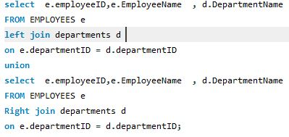
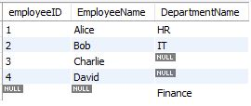
4. Full join :-
•Retrieves all records when there is a match in either left or right table. Returns NULLs where there’s no match.
Syntax :-
Show records from both tables, filling NULLs where there are no matches.
Output :-

Slide 9
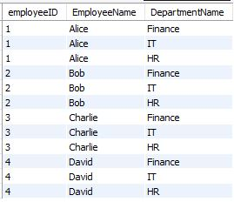
5. Cross join :-
Returns the Cartesian product of two tables, combining all rows from both tables
Syntax :-
Select e.EmpID,e.EmpName,d.DeptName FROM Employees e cross JOIN Departments d
•Show a simple example of a Cartesian product.
Output :-

Slide 10
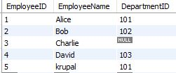
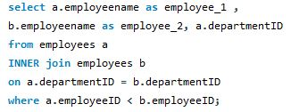

Self join :-
•: A join in which a table is joined with itself.
Syntax :-
Output :-
Use cases like finding hierarchical relationships.

Slide 11
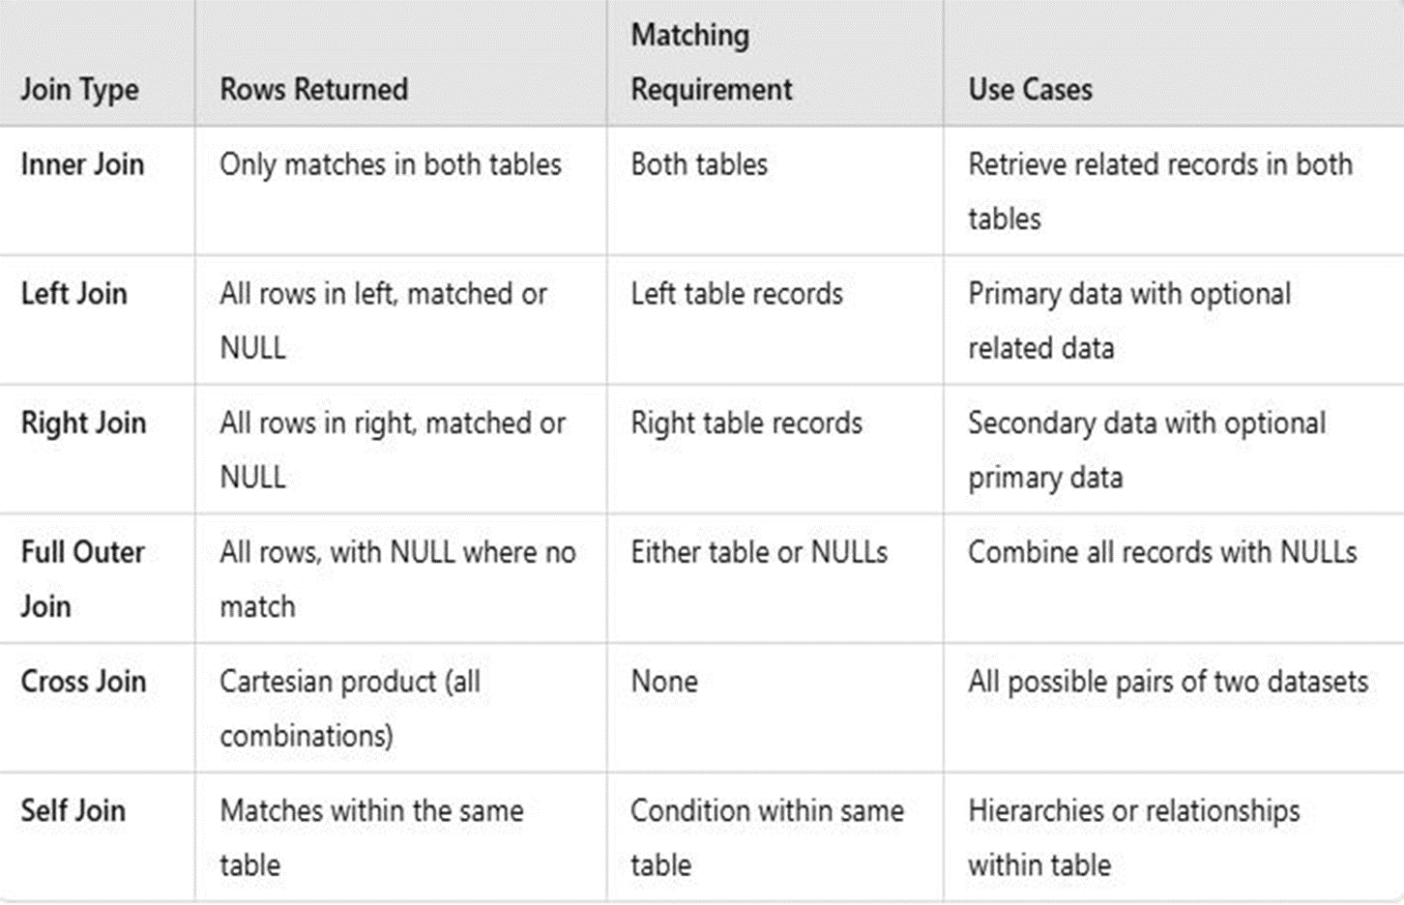
Comparison Summary :-

Slide 12
Q & A

